Slide 1
Welcome to Arabic
New Paltz High School

Slide 2
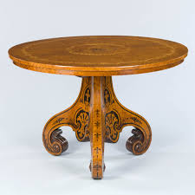
In Arabic?
Table

Slide 3
Now say my book is on the table.

Slide 4

In Arabic
Window

Slide 5
Now say, my phone is next to the window

Slide 6
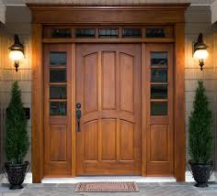
In Arabic
Door

Slide 7
Say: there is a tree next to the door

Slide 8
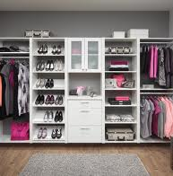
In Arabic
Closet

Slide 9
Say: my shirt is in the closet

Slide 10

In Arabic
Bed

Slide 11
Say: My dog is under the bed

Slide 12
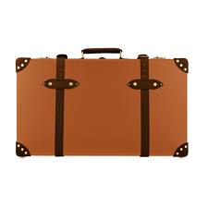
In Arabic
Suite case

Slide 13
Say: my suite case is heavy.

Slide 14
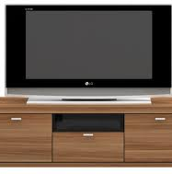
Say I have a TV and it’s on the table

